Slide 1
Be Well
Design Proposal for Final Project Application
by Adarsh Venkatesh Bodineni
SUID: 437100794
Course: Mobile Application Programming

Slide 2
Name of the App: “Be Well”
Targeted users of the Application:
Can categorize audience as Doctors, patients and pharmacists.
1. Doctors:
For prescribing medicines to patients.
2. Patients:
For taking pills on time.
For ordering medicines from home just by scanning barcode label of that medicine.
3. Pharmacists:
To receive orders from patients for medicines.
To notify patients that medicines are packed and ready for pickup.

Slide 3
Usefulness/Uniqueness of the Application:
This application provides platforms for three different types of customers. The unique way of reminding patients to take medicines on time will help them stay healthy. The ability to order medicines just by scanning the barcode label of medicine and the notification facility from the pharmacist that medicines are packed saves a lot of time for the patients instead of going there and waiting in queue. Even if the doctor is in some remote location, still he can be able to prescribe things for the patients.
Research done on the similar Apps from App Store:
1. In App Store there are applications that can be used only by the patients for ordering medicines and for alert
to take pills on time. But my application provides platform for three categories of users.
2. In App Store the applications doesn’t provide health practices, but my application will display health practices
from the facebook pages.
3. In App Store there are many applications that doesn’t provide the capability of barcode scanning of the medicines
Label, my applications provides this feature.

Slide 4
Vision and Scope of the Application:
Till now , I have visualized the application as mentioned in the following slides.
As I start developing , I am considering to add more features like usage of camera, gallery, different custom
made animations, embedding machine learning and many more features.
The next slide describes the complete flow of the application and the following slides describes each
And every screen functionalities, technologies that will be used and the Model used for the screen.

Slide 5
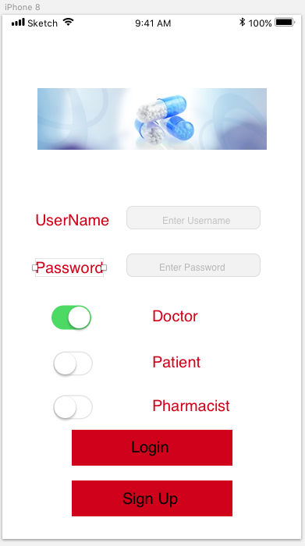
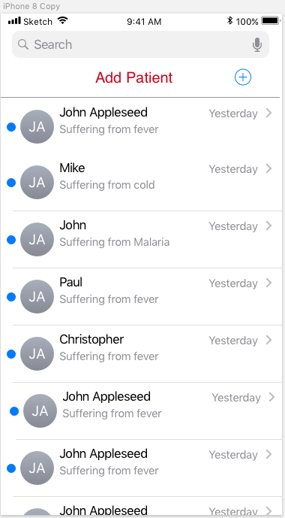
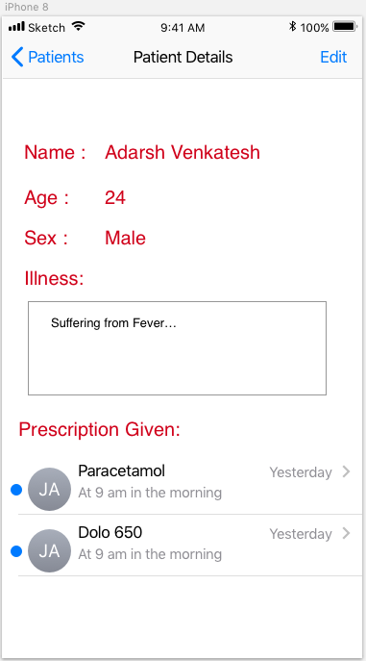
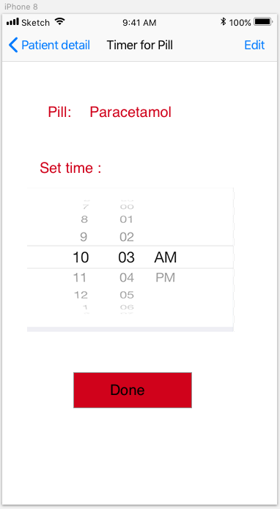
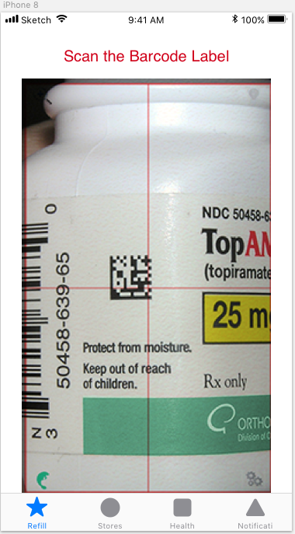
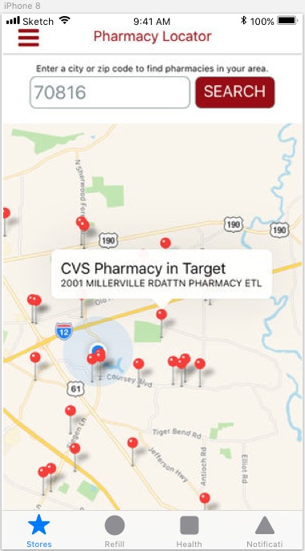
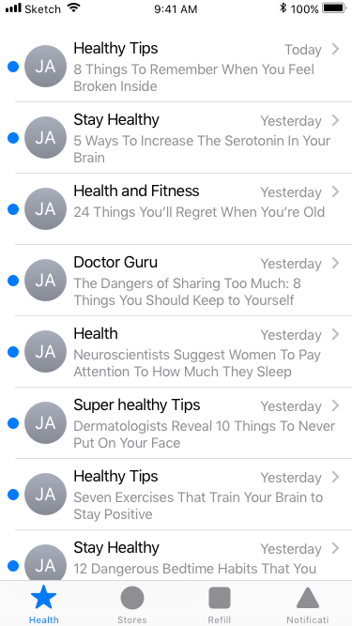
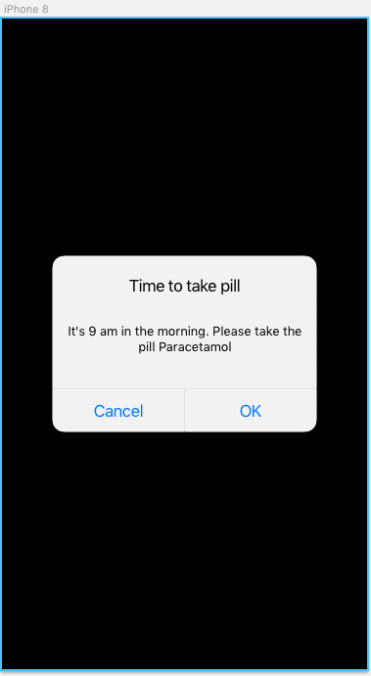
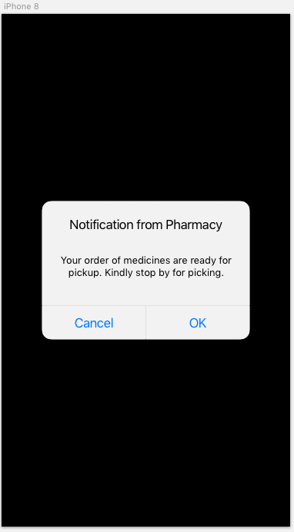
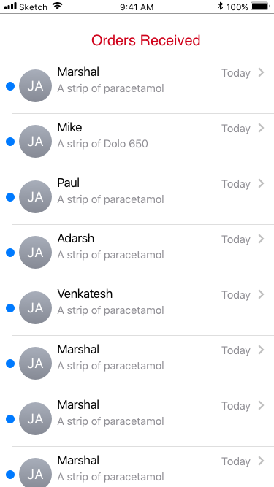
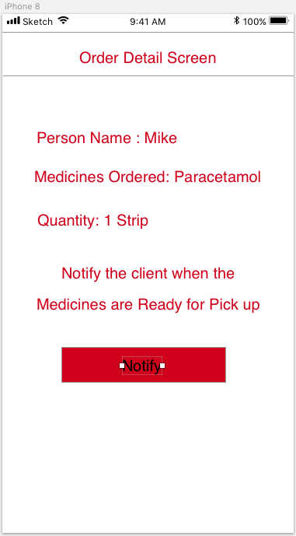

Slide 6
Login Screen
This is the Login screen for the application, the user can specify
the category he is, i.e whether he is a doctor or patient or pharmacist.
Based on the category specified , the particular screen will be loaded
for that user.
Firebase authentication will be used for logging in into the application.
Facebook login will also be implemented.

Slide 7
Add Patient Screen
This screen is available for the doctor.
This view will developed using TableViewController
This view contains all the list of patients
Model: The fields that each cell here will contain are the name,
and the disease the patient suffering from.
On clicking on patient, the detail screen of the patient is displayed.
Here the doctor can also add new patients into his list of patients by
tapping on add patient button

Slide 8
Patient Detail Screen
This screen is available for the doctor.
This view contains the details of the patient
Model: The Model for this screen contains all the patient details like
name, age, sex, disease, list of prescriptions given.
In this view the doctor can edit the patient details or add
prescriptions to patient.
In this view On clicking on the prescription, the doctor can set time
when to take the medicine for the patient.
Future scope for this screen will have a profile picture that will be
uploaded using camera or gallery.

Slide 9
Time set for Pill Screen
This screen is available for the doctor.
This view will have a timer to set for particular prescription.
At this time , the patient will be notified that he have to take that pill.

Slide 10
BarCode Scan Screen
This screen is available for the Patient. TabView Controller
will be used for patient
This view controller will have functionality to scan the
barcode of the medicine.
And then he can order medicines.

Slide 11
Maps showing near by pharmacies Screen
This screen is available for the Patient. TabView Controller
will be used for patient
Google maps/Apple Maps will be used for this screen
This view controller will access the google maps to show
all the nearby available pharmacies to the patient.

Slide 12
Health Tips Screen
This screen is available for the Patient. TabView Controller
will be used for patient
This view will be developed using TableViewController
The data will be retrieved from facebook pages
The Facebook graph API will be used to fetch data.
This screen will provide health tips to the patient

Slide 13
Notifications Screen
This screen is available for the patient.
There are two types of notifications that the patient will
receive.
One is set by the doctor for taking pills on time.
One will be set by the pharmacist that the medicines that
are ordered are ready for pickup
One Signal REST API will be used for message passing from the
Pharmacist to the patient.

Slide 14
Orders Screen
This screen is available for the Pharmacist.
This view will be developed using TableViewController
This view will have the list of orders the patients have done.
On tapping on each order, order detail screen will be loaded .
Model: The Model data here is the patient name, and the
medicine that is ordered.

Slide 15
Order Detail Screen
This screen is available for the Pharmacist.
This screen will have the order details
The Model for this screen will have all the order details
like patient’s name, medicine that is ordered, quantity of medicine ,
Once the medicines are packed, the pharmacist can notify
patient that his medicines are packed and ready for pickup just by
tapping on the notify button.

